Slide 1

Python Data Analysis

Slide 2
Camera Expectations

Slide 3



Before we start… Please have your camera switched on.
Camera Expectations
This is a mandatory requirement for the duration of the course.
You are studying a regulated qualification, your tutor needs to see that it is the right person participating throughout the course.
Our job is to prepare you for work in an age where in almost any job there is likely to be at least some aspect of remote engagement with your employer.
Online learning is to be treated the same way as a classroom learning, you must be physically visible to interact with your tutor and other learners in order to create an engaging group dynamic.

Slide 4


Background filters
If you do not wish to have your camera displaying your personal environment, Microsoft Teams has a solution to this problem…
Step One: Before you join a Teams video call, click the ‘Background Filters’ option.
Step Two: On the right-hand side, you can select any of the stock images.
Step Three: The image you choose will then appear in your background on the video call.
If you need any further support in regards to this requirement, please speak to your tutor directly.

Slide 5



Starter Activity
How to look after your mental health & wellbeing?

Slide 6
Objectives
Pandas
Pandas DataFrame
DataFrame Indexing
DataFrame Inspecting

Slide 7

Formative Assessment
Students are requested to complete the following short assessment to help us identify what they know about the topic at present. Note: This is an ungraded assessment.
It is okay if students do not know the answers yet.
Link: https://forms.office.com/e/jF7yKP6fCr

Slide 8
Pandas
Bootcamp
Pandas is a Python library used for working with data sets.
It has functions for analysing, cleaning, exploring, and manipulating data.
A Pandas DataFrame is a 2 dimensional data structure, like a 2 dimensional array, or a table with rows and columns.
A Pandas Series is like a column in a table. It is a one-dimensional array holding data of any type.
Notes:
Official summary: https://www.python.org/doc/essays/blurb/
Image source: https://www.python.org/static/img/python-logo@2x.png

Slide 9
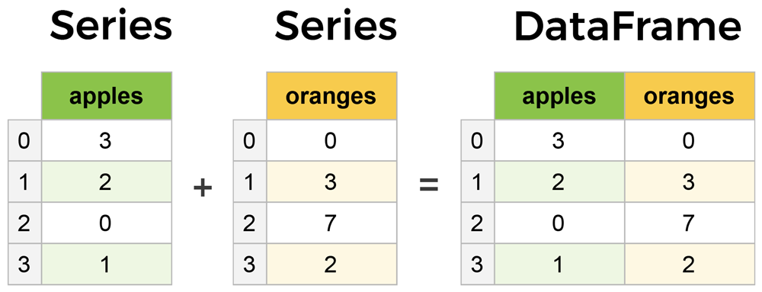
Pandas Series
Notes:
Source link: https://www.learndatasci.com/tutorials/python-pandas-tutorial-complete-introduction-for-beginners/

Slide 10
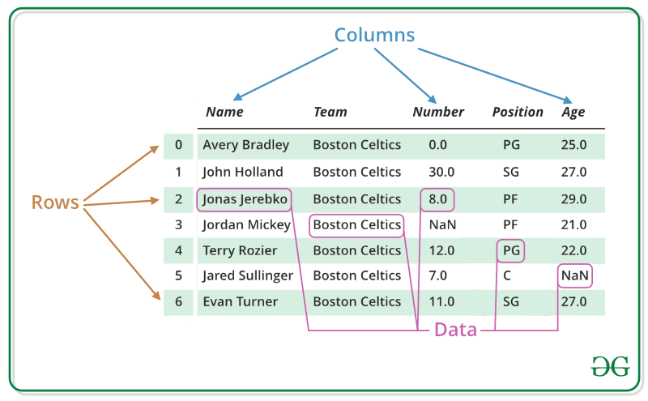
Understanding DataFrame
Bootcamp
Notes:
Source link: https://www.geeksforgeeks.org/python-pandas-series/

Slide 11
Creating Pandas DataFrame
Bootcamp
import pandas as pd data = { "calories": [420, 380, 390], "duration": [50, 40, 45] } #load data into a DataFrame object: df = pd.DataFrame(data) print(df)
import pandas as pd
data = [12, 22, 44],[50, 44, 12]
df = pd.DataFrame(data)
print(df)

Slide 12
Importing Spreadsheets
A simple way to store big data sets is to use CSV files (comma separated files).
CSV files contains plain text and is a well know format that can be read by everyone including Pandas.
In our examples we will be using a CSV file called 'data.csv'.
df = pd.read_csv(‘student.csv’)

Slide 13
Subsetting df
Bootcamp
Selecting a single column using the column name :
df['column_name'] # Or df.column_name # Only for single column selection
Selecting multiple columns using the column names
df[['column_1', 'column_2', ...]]

Slide 14
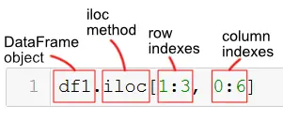
Locating Data in df
With loc and iloc you can do practically any data selection operation on DataFrames you can think of.
loc is label-based, which means that you have to specify rows and columns based on their row and column labels.
iloc is integer index based, so you have to specify rows and columns by their integer index like you did in the previous exercise.

Slide 15
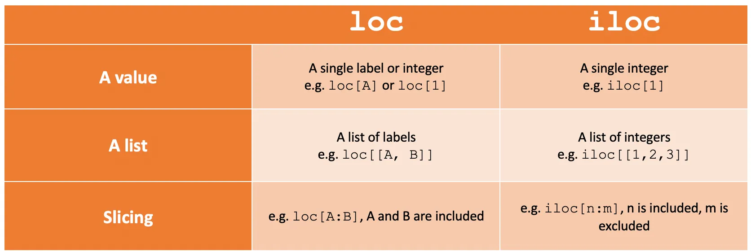
Locating Data in df
Notes:
https://towardsdatascience.com/how-to-use-loc-and-iloc-for-selecting-data-in-pandas-bd09cb4c3d79

Slide 16
Loc and iloc
Selecting a single column and all the rows using the .loc attribute
df.loc[:, ‘column’]
Selecting multiple columns and all the rows using the .loc attribute
df.loc[:, ['column_1', 'column_2', ...]]
Selecting a single column and all the rows using the .iloc attribute
the .iloc attribute selects Pandas data by position (column index)
df.iloc[:, 0]
Selecting multiple columns and all the rows using the .iloc attribute
df.iloc[:, [0, 2, 10]]
df.iloc[:, 0:5]

Slide 17
Selecting Rows and Columns
Selecting a single row using the .iloc attribute
df.iloc[[0]]
Selecting multiple rows using the .iloc attribute
df.iloc[[row_index_1, row_index_2, ...]]
Selecting consecutive rows and columns using the .loc and .iloc attributes
df.iloc[0:6, 0:5]

Slide 18
Filtering df
When we select rows and columns based on specific criteria or conditions, it is referred to as Filtering.
Filtering based on a single criterion with all columns
df[df[‘Column1'] > value]
Filtering based on two criteria with AND operator
df[(df[' Column1'] > value) & (df[' Column1 '] < value)]
Filtering based on two criteria with OR operator
df[(df[' Column1'] > value) | (df[' Column1 '] < value)]

Slide 19
Inspecting df
Check data types of each column
df.dtypes
DataFrame information check
df.info()
Get DataFrame column names
df.columns

Slide 20
Inspecting df
Check top/bottom rows
df.head() / df.tail()
DataFrame dimension check
df.shape
DataFrame missing value check (Column-wise)
df.isnull().sum()
DataFrame total missing value check
df.isnull().sum().sum()

Slide 21
Inspecting df
Renaming a columns
df.rename( columns={'current_name' : 'newName' },inplace=True)
Drop all rows that contain null values
df.dropna()
Return a Series containing counts of unique values.
df['your_column'].value_counts()

Slide 22
Recap Questions
What is a correct syntax to create a Pandas DataFrame?
a) pd.DataFrame(data) b) pd.dataframe(data) c) pd.df(data)
What is a correct syntax to return the first row in a Pandas DataFrame?
a) df.loc[0] b) df.get(0) c) df[0]
What is the correct Pandas function for loading CSV files into a DataFrame?
a) pd.readfile() b) pd.read_csv() c) pd.readCSV()

Slide 23
Statistical Summary
df.describe() | Summary statistics for numerical columns
df.mean() | Returns the mean of all columns
df.corr() | Returns the correlation between columns in a DataFrame
df.count() | Returns the number of non-null values in each DataFrame column
df.max() | Returns the highest value in each column
df.min() | Returns the lowest value in each column
df.median() | Returns the median of each column
df.std() | Returns the standard deviation of each column

